Slide 1
Grover on SM3
Gyeongju Song, Kyoungbae Jang, Hyunji Kim, Wai-Kong Lee,
Zhi Hu, and Hwajeong Seo

Slide 2
Contents
Introduction
Related Work
Grover on SM3
Conclusion

Slide 3

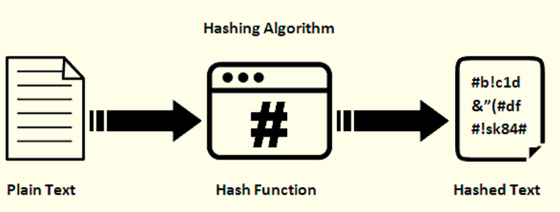
Introduction
Grover’s algorithm in Quantum Computers
: Find unsorted data very fast.
What if the Grover’s algorithm is applied to the hash function?
- The hash function can be attacked by accelerating the pre-image attack.

Slide 4
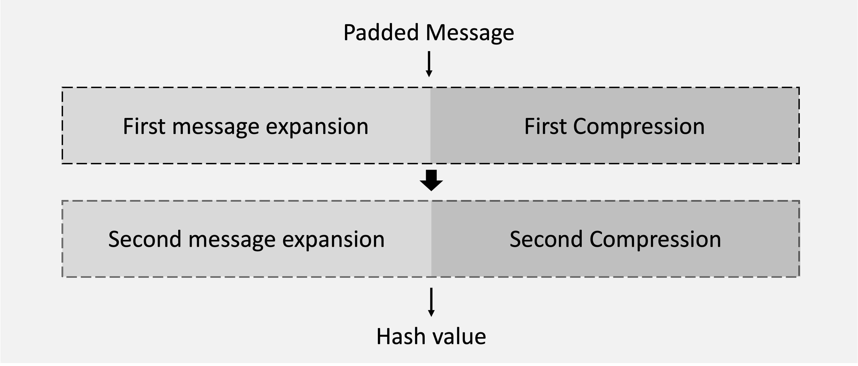
Introduction
Implementation of quantum circuit for hash function
The design of Grover’s algorithm for pre-image attack requires a quantum circuit of the target hash function.
Our paper
Propose an optimal SM3 hash function in a quantum circuit.
- Estimate the quantum resources required for the quantum pre-image attack.

Slide 5
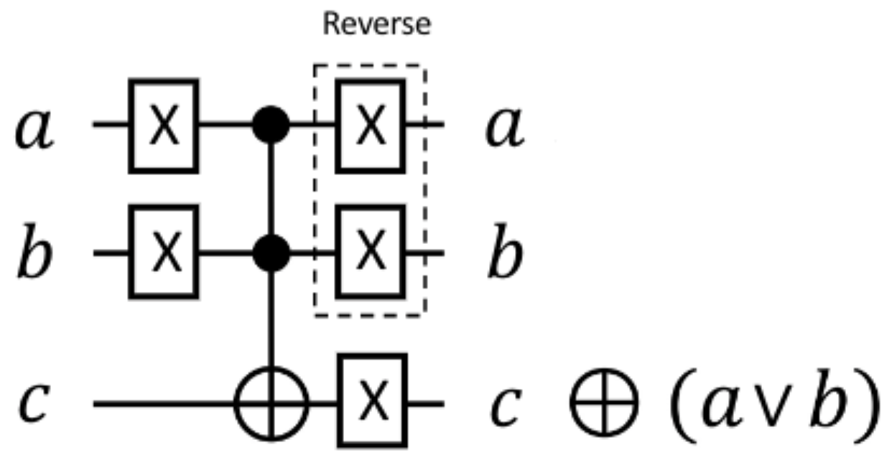
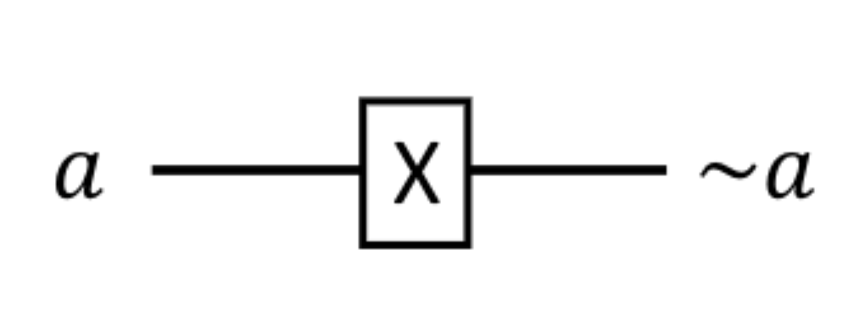
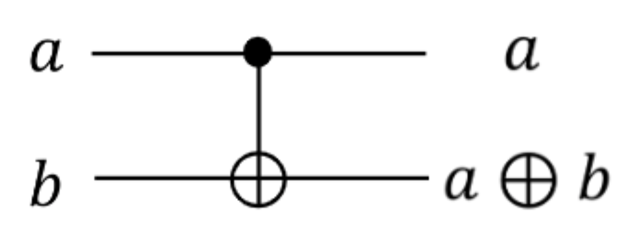
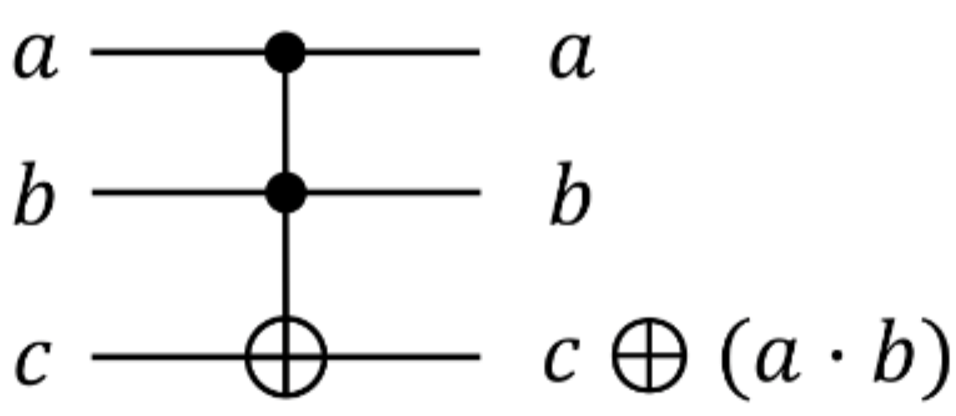
Related Work
Quantum Computing
Quantum computers can perform fast computations using qubits.
Qubit : It has both 0 and 1 probabilistically at the same time.
The state of a qubit is changed through quantum gates.
Quantum gates : (1) X gate (2) CNOT gate (3) Toffoli gate (4) OR gate
(1) X gate
(2) CNOT gate
(3) Toffoli gate
(4) OR gate

Slide 6
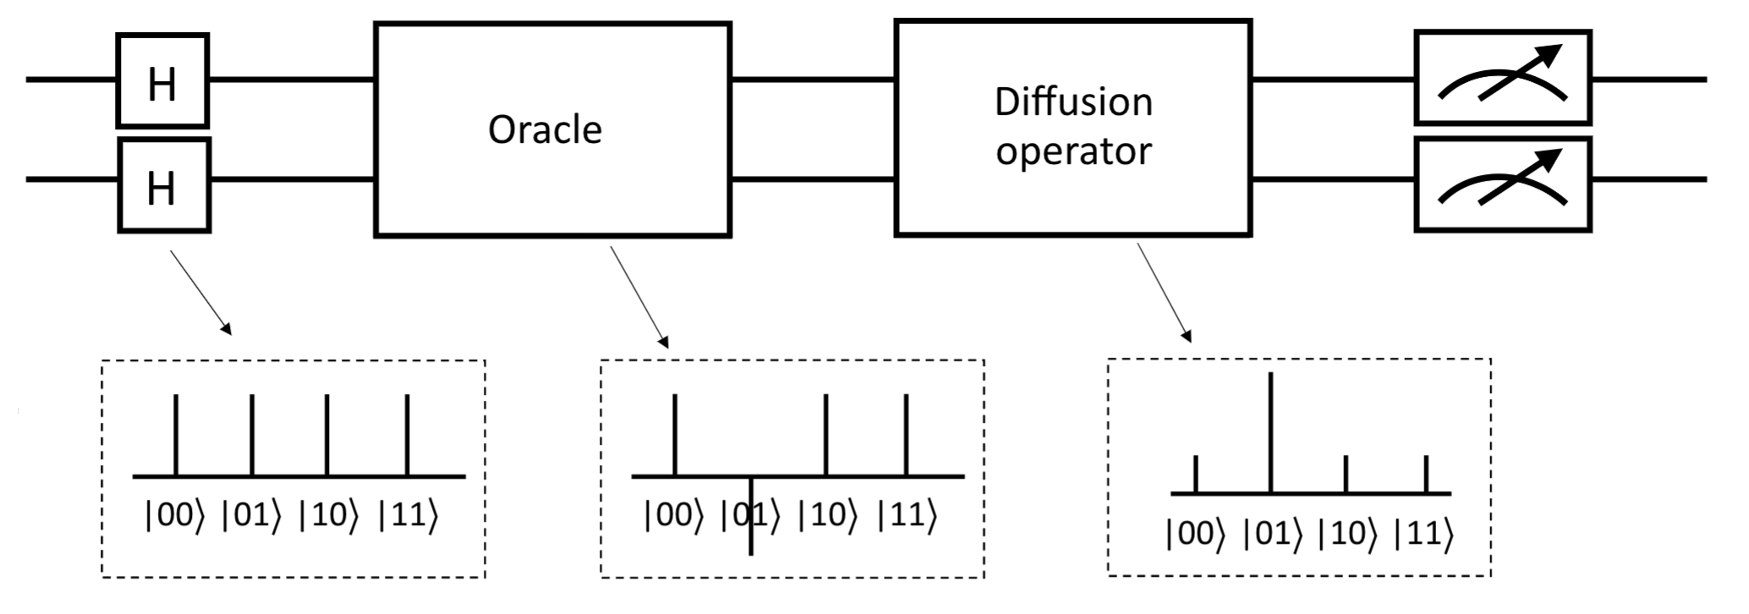

Related Work
Grover algorithm : Grover’s search algorithm consists of oracle and diffusion operators.
Oracle function $f(x)$ : Returns 1 when x is the answer, and it inverts the phase of qubits representing the answer.
Diffusion operator : Amplifies the amplitude of inverted qubits through the oracle, increasing the probability of becoming the answer.
Through repetition of the oracle and diffusion process, the probability of the answer is over the threshold.

Slide 7
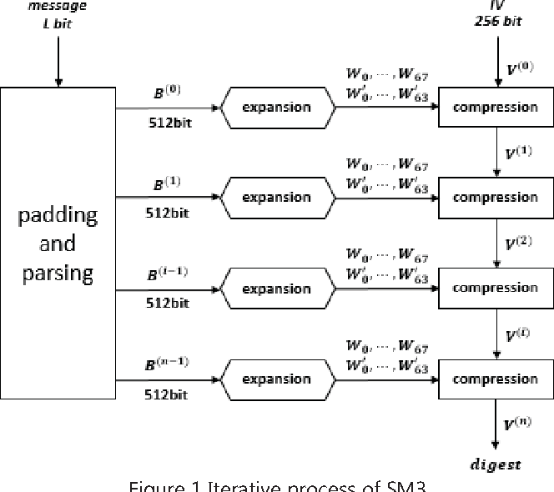
Related Work
SM3
The SM3 hash function used in the Chinese national standard
It operates with 32 words
It operates in the order of message padding, expansion, and compression.
Finally, output a hash value of 256 bits

Slide 8
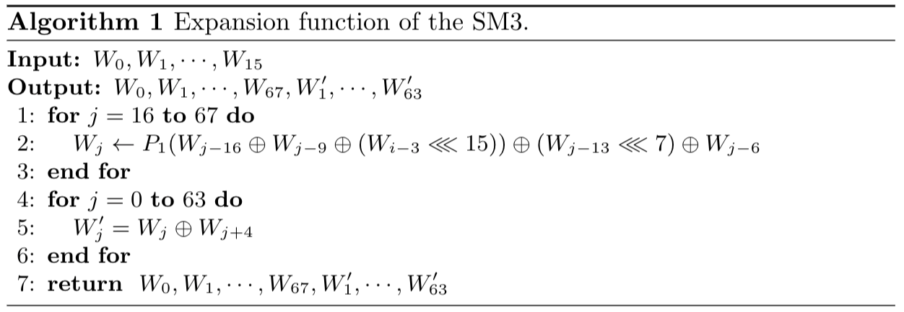

Related Work
SM3 – Expansion function
Message block $B^{(i)}$ is divided into 16 words $W_{0},W_{1}, ⋯,W_{15}$and works.
$W_{0},W_{1}, ⋯,W_{15}$expand to $W_{0},W_{1}, ⋯,W_{67}, {W^{′}}_{0}, {⋯,W′}_{63}$ .

Slide 9
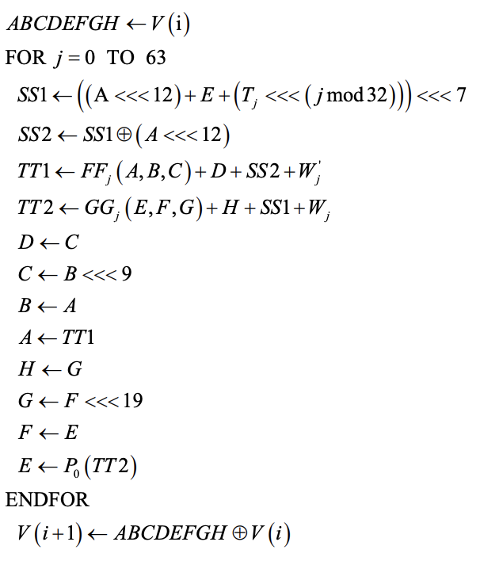
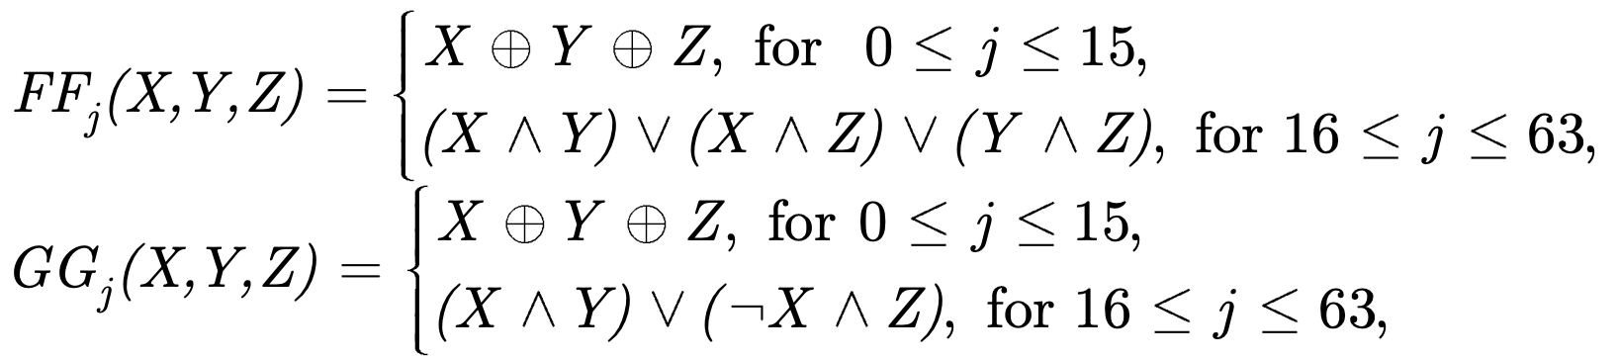
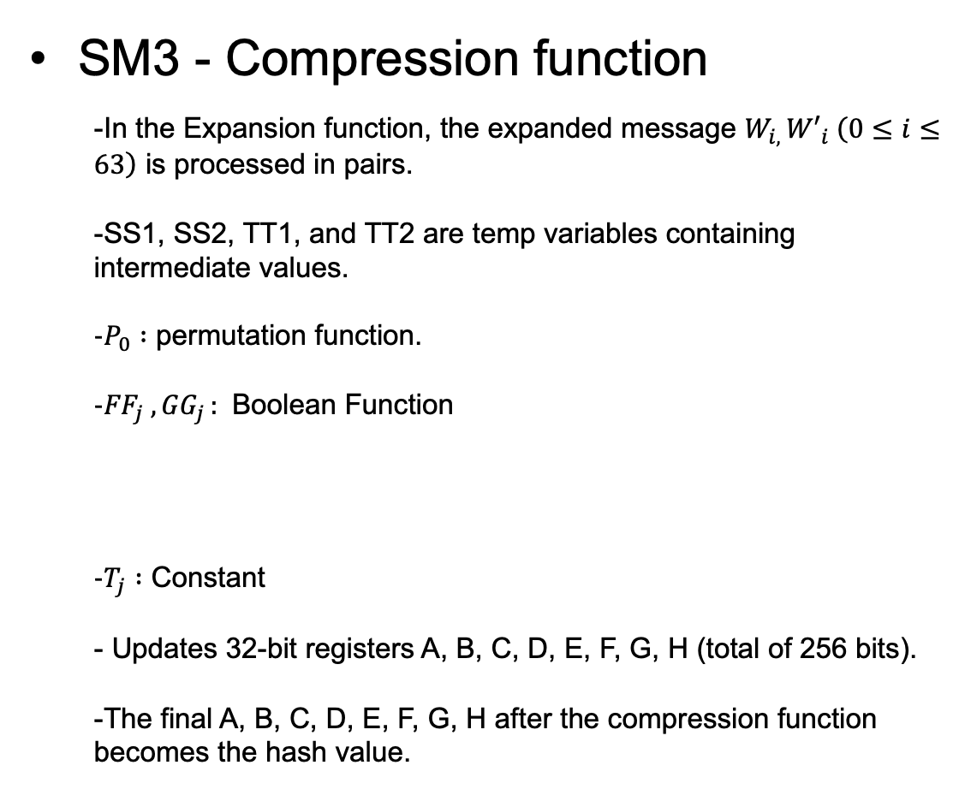
Related Work
SM3 - Compression function
In the Expansion function, the expanded message $W_{i, }{W′}_{i} \left(0≤i≤63\right)$ is processed in pairs.
SS1, SS2, TT1, and TT2 are temp variables containing intermediate values.
$P_{0} :$ permutation function.
${FF}_{j} , {GG}_{j }:$ Boolean Function
$T_{j} :$ Constant
Updates 32-bit registers A, B, C, D, E, F, G, H (total of 256 bits).
The final A, B, C, D, E, F, G, H after the compression function becomes the hash value.

Slide 10
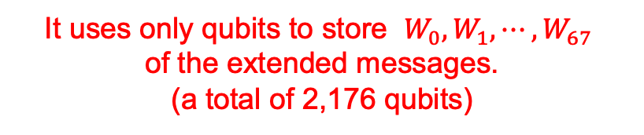
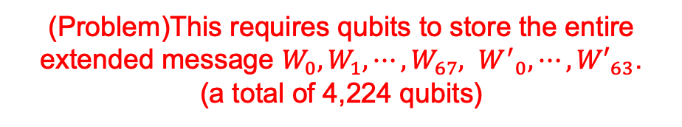
Grover on SM3
Padding Message
Padding Message
First Expansion
Expansion
First Compression
Compression
Second Expansion
Second Compression
Hash value
Hash value
<SM3 operation>
<SM3 quantum circuit operation>
(Problem)This requires qubits to store the entire
extended message $W_{0},W_{1}, ⋯,W_{67}, {W^{′}}_{0}, {⋯,W′}_{63}$.
(a total of 4,224 qubits)
It uses only qubits to store $W_{0},W_{1}, ⋯,W_{67}$
of the extended messages.
(a total of 2,176 qubits)

Slide 11
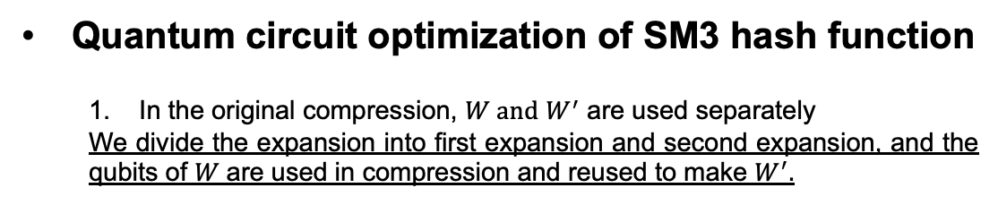


Grover on SM3
Quantum circuit optimization of SM3 hash function
In the original compression, $W and$ $W^{′}$ are used separately
We divide the expansion into first expansion and second expansion, and the qubits of 𝑊 are used in compression and reused to make $W^{′}.$
SM3 compression
SM3 expansion
$W and$ $W^{′}$ are used separately
First expansion
$⋇W_{0}, ⋯,W_{67}$ must not change.
Second expansion

Slide 12
Grover on SM3
Quantum circuit optimization of SM3 hash function
2. In the original Compression, $W^{′}$ is used first, followed by 𝑊.
Changed the order of compression operations to use $W$ before $W^{′}$.
First compression
Second compression

Slide 13
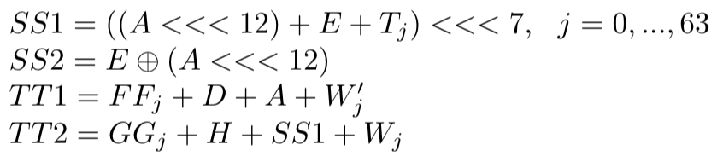
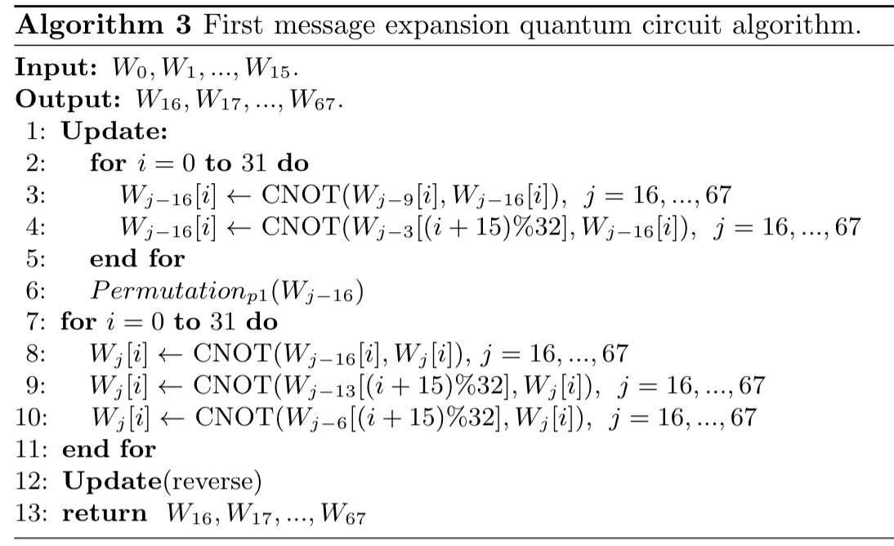
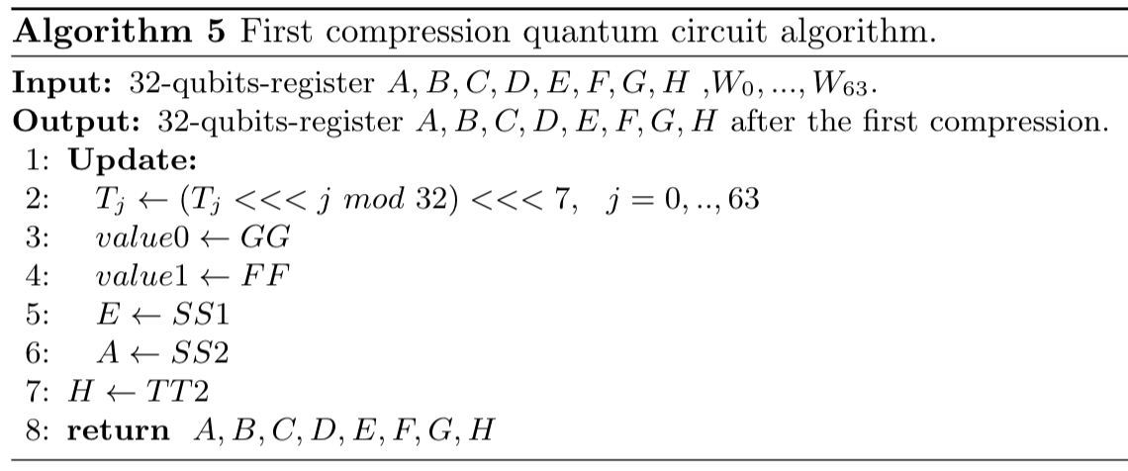

Grover on SM3
First Expansion
First Compression
First expansion
First compression
$⋇$To reuse the qubits used for AND, OR operations of 𝐺𝐺 and 𝐹𝐹, the values of 𝐺𝐺 and 𝐹𝐹 are reversed and reused in the next round.
$⋇$Since the value of $W_{0}, ⋯,W_{67}$ should not be changed, the changed value is returned while updating through the reverse operation.

Slide 14
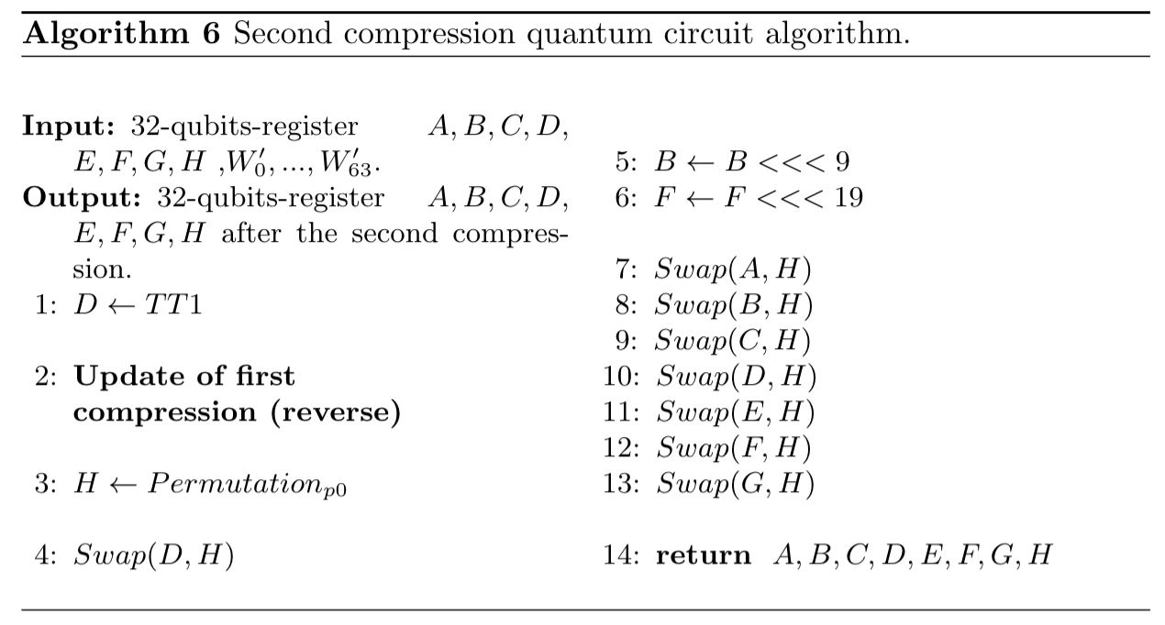
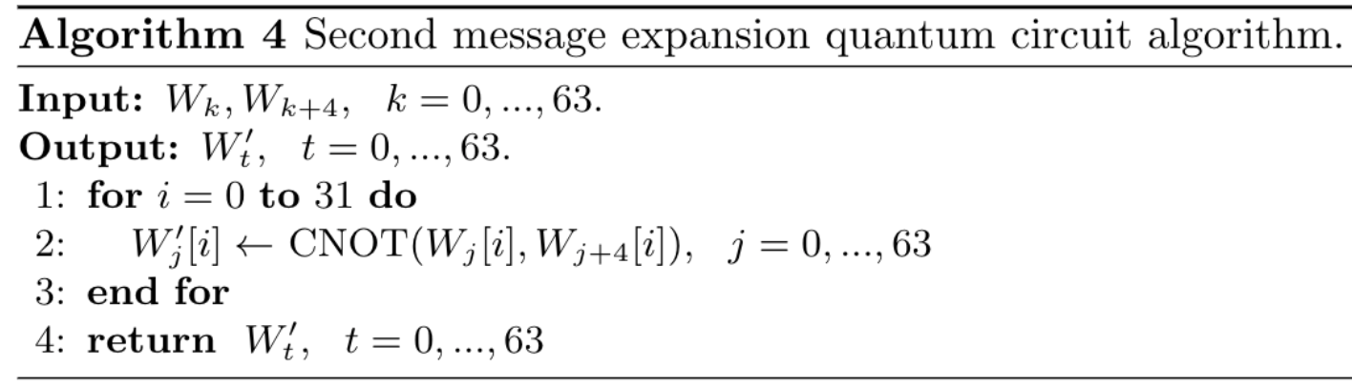
Grover on SM3
Second Expansion
Second compression
Second Compression
After using 𝐹𝐹, reverse the update of the first compression.
Second expansion

Slide 15

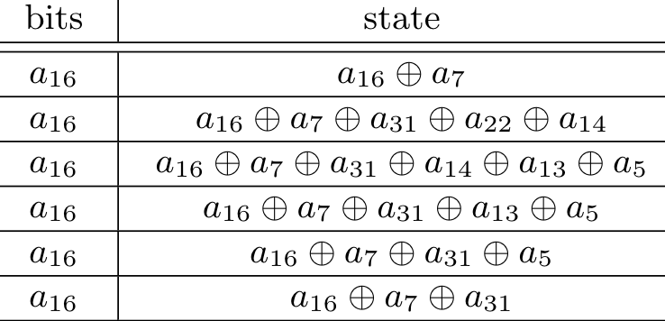
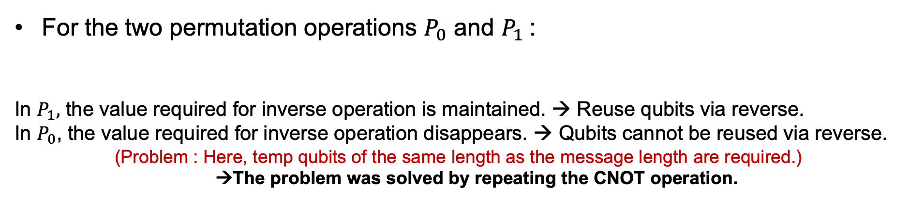
Grover on SM3
For the two permutation operations $P_{0}$ and $P_{1}$:
In $P_{1},$ the value required for inverse operation is maintained. → Reuse qubits via reverse.
In $P_{0}$, the value required for inverse operation disappears. → Qubits cannot be reused via reverse.
(Problem : Here, temp qubits of the same length as the message length are required.)
→The problem was solved by repeating the CNOT operation.
Expansion function
Compression function
${Exaple) Calculate a}_{16}=a_{16}⊕a_{17}⊕ a_{31}$ (Where, $a_{31}= a_{31}⊕a_{22}⊕a_{14}, { a}_{22}=a_{22}⊕a_{13}⊕a_{5}$)
Qubits
CNOT | (a[7], a[16])
CNOT | (a[31], a[16])
CNOT | (a[22], a[16])
CNOT | (a[14], a[16])
CNOT | (a[13], a[16])
CNOT | (a[5], a[16])

Slide 16
Conclusion
Quantum resource estimation result for SM3 quantum circuit
- Quantum circuit are implement and resources estimate using Project Q, IBM＇s quantum programming tool.
- The estimated resource can be used as data to evaluate the strength of the hash function in the future.
First implementation of the SM3 hash function in a quantum circuit.
Efficient design of SM3 operations in a quantum circuit.
Quantum resource estimation of Grover’s algorithm for the SM3 hash function.
< Resource estimation of SM3 quantum circuit >
 | Qubits | Toffoli gates | CNOT gates | X gates | Depth
SM3 | 2,721 | 43,328 | 134,144 | 2,638 | 128,129

